Slide 1
M.C.R. Jetty A Rehab
Dustin Lehman

Slide 2
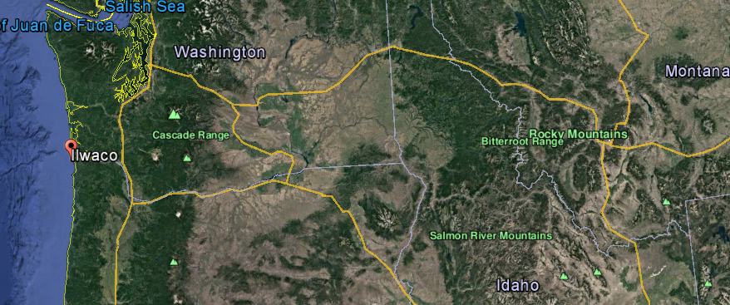
MCR Jetty A Rehab.
  Overview
Project Award: Sept 30, 2015
Stop Work Order: October 13, 2015
NTP #1: January 15, 2016
Stop Work Order: January 29, 2016
NTP #2: April 29, 2016
Notes:
Project is located near Ilwaco, Washington at the mouth of the Columbia River.

Slide 3
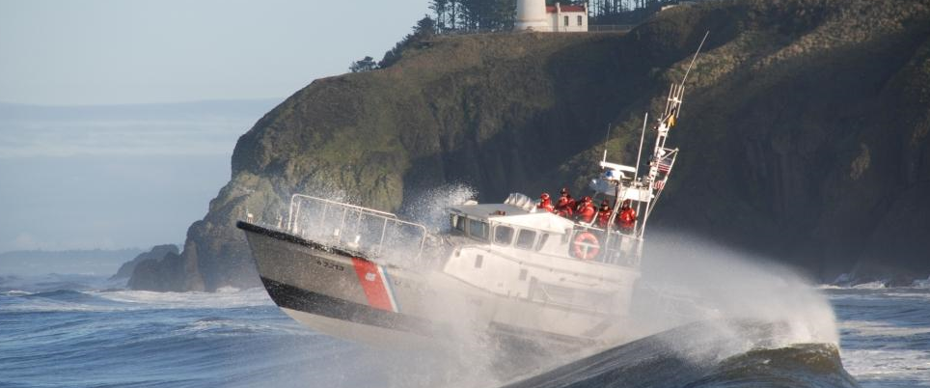
MCR Jetty A Rehab.
  Overview
Project Award: Sept 30, 2015
Stop Work Order: October 13, 2015
NTP #1: January 15, 2016
Stop Work Order: January 29, 2016
NTP #2: April 29, 2016
Notes:
The project is located on the US Coast Guard Base called, “Cape Disappointment”. It was established in 1877 and is the largest Search and Rescue Station on the Northwest Coast with 50 crew members.
The Coast Guard responds to 300-400 calls for help each year.

Slide 4
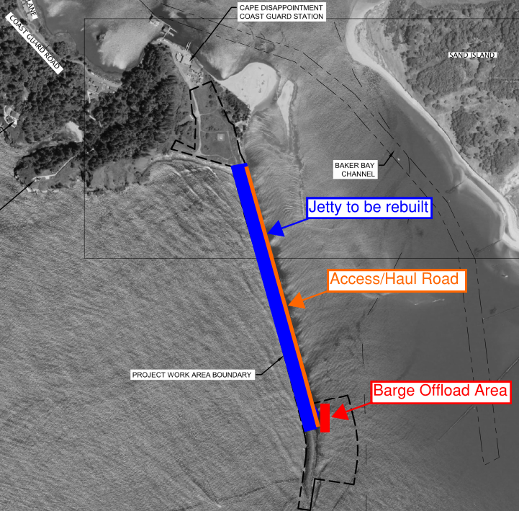
MCR Jetty A Rehab.
  Overview
Owner: USACE Portland District
Contract Type: Best Value
Base Bid plus Options
Engineers Estimate: $10-25M
Notes:
Originally built in early 1900’s using rail cars and existing rock from onsite.
Has been extremely damaged since then and needs to be repaired.
So, what is the importance of this project?
The mouth of the Columbia River is comprised of 3 jetties: The North Jetty, South Jetty and Jetty A.
The jetties are necessary for the safety of ships entering the Columbia River navigational channel.
It is important the jetties are maintained because they support:
$20 Billion in international trade
42 million tons of cargo
3,500 Cargo Vessel crossings (1,400 crossings require 30’ or greater of draft)
And the trade supports over 40,000 jobs

Slide 5
MCR Jetty A Rehab.
  Project Schedule
All CLINs except CLIN 0008:
  Notice To Proceed: October 15, 2016
  Jetty Construction Physical Completion Date: September 30, 2017
  Site Restoration Construction Physical Completion Date: 270 calendar days after Jetty Construction Physical Completion Date
  Jetty Contract End Date: 90 calendar days after Site Restoration Construction Physical Completion Date
Mitigation (CLIN 0008)
  Mitigation Construction Physical Completion Date: As per Section 32 92 23.00 25 Eelgrass Planting or 5 years after initial planting
  Mitigation Contract End Date: 90 days after the Mitigation Construction Physical Completion Date

Slide 6
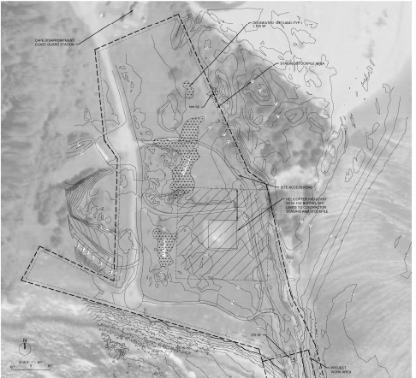
MCR Jetty A Rehab.
  Overview
7 Acre site for laydown and stockpile
Must maintain 100’ buffer around helipad
Wetlands are within construction limits
Access is through the U.S. Coast Guard Base

Slide 7
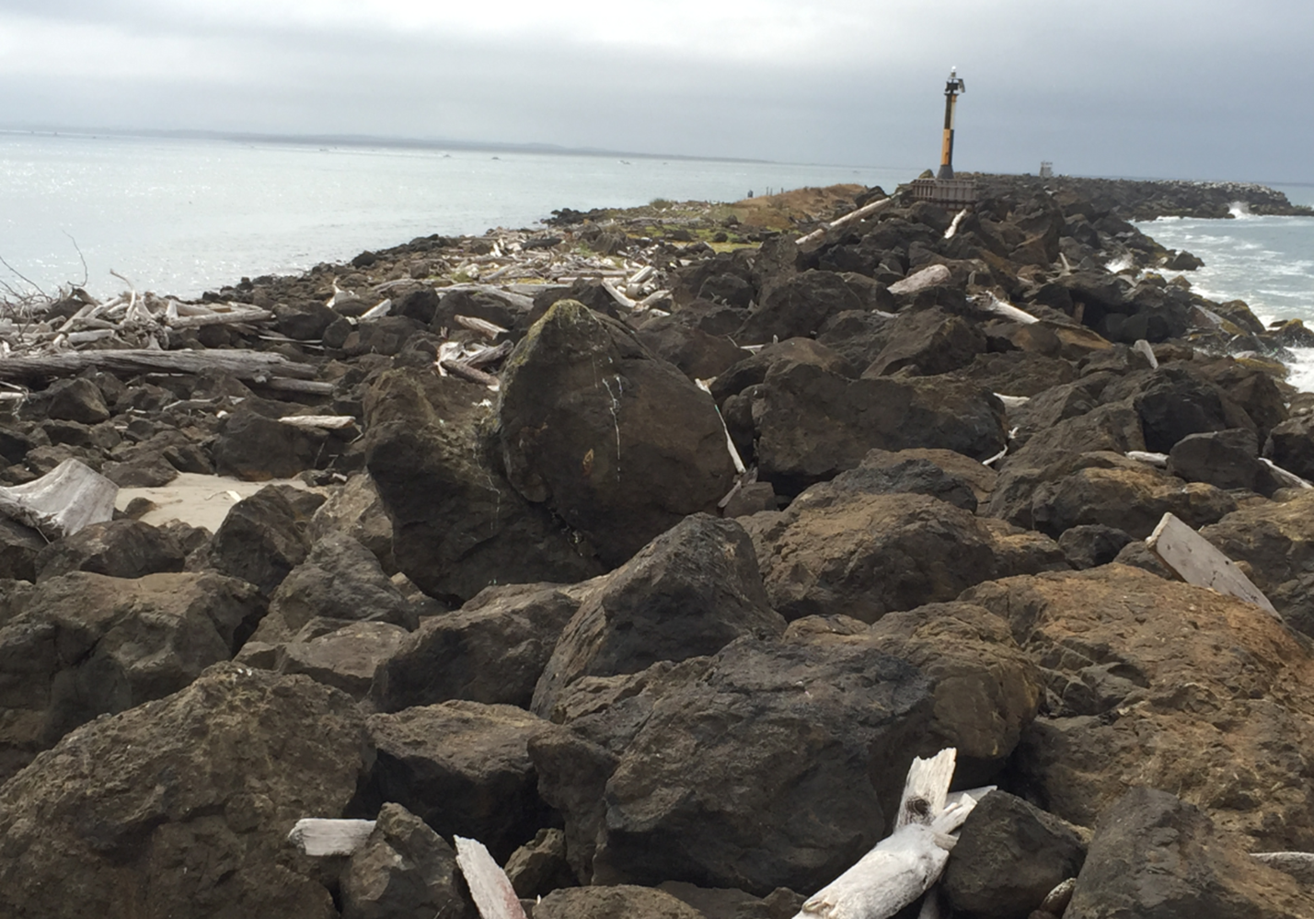
MCR Jetty A Rehab.
  Overview

Slide 8
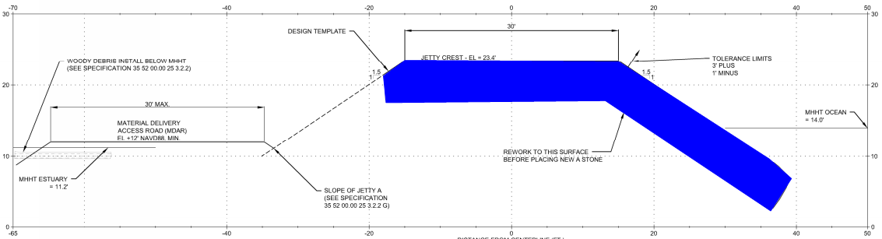
Typical Cross Section
A- Stone 6-22 Ton

Slide 9
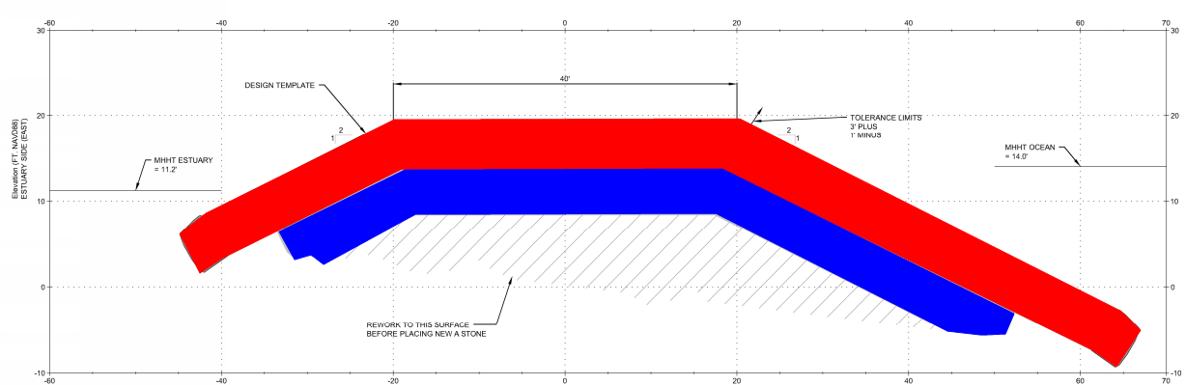
Typical Cross Section
A- Stone 6-22 Ton
A- Select 15-22 Ton

Slide 10

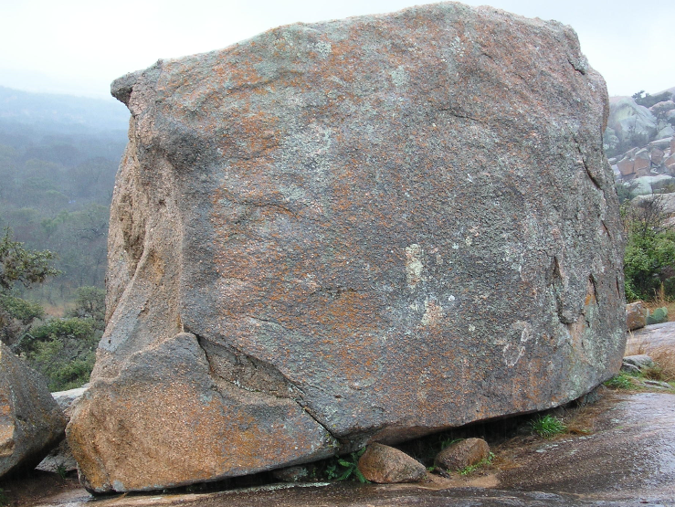
MCR Jetty A Rehab.
  Overview
22 Ton Stones

Slide 11
MCR Jetty A Rehab.
  Quarry Sources
Beaver Lake Quarry – Mount Vernon, WA
Hooker Creek – Bend, OR
Columbia Granite – Olympia, WA
Big River – Astoria, OR
Central Oregon Basalt – Madres, OR
Tasu Quarry - Queen Charlotte Islands, B.C., Canada

Slide 12
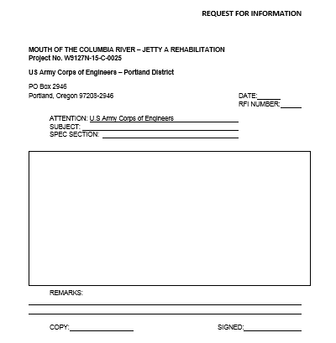
MCR Jetty A Rehab.
  RFI Procedure
RFI’s to be hand written and submitted on the appropriate form.
RFI’s will be accepted between:
  10am to 1pm
  3pm to 5pm
  8pm to 9pm
All teams will receive RFI responses for all RFI’s.

Slide 13
MCR Jetty A Rehab.
  Project Scoring
Bid Package…………………………………………………………. 375 points
Volume I
Factor 4: Procurement
Sub-factor 1: Quarry Production 50 points
Sub-factor 2: Jetty Stone Delivery Plan 50 points
Factor 5: Project Execution
Sub-factor 1: Jetty Stone Placement 50 points
Sub-factor 2: Schedule 75 points

Slide 14
MCR Jetty A Rehab.
  Project Scoring
Volume II Price
Tab 1—SF1442 Solicitation, Offer, and award 50 points
Tab 2—Section 00010,Proposal Price/Bid Schedule 50 points
Tab 3—Representations, Certifications 25 points
Tab 4— Bid/Offer Guarantee 25 points

Slide 15
MCR Jetty A Rehab.
  Project Scoring
Risk Analysis Write Up…………………………………………… 100
Back up, takeoff, pricing…….…………………………………… 100
Winning Bid (Closest to Kiewit bid)……………………………. 25
Oral Presentation and Q&A……………………………………… 400
Total: 1,000 points

Slide 16
MCR Jetty A Rehab.
  Bid Submission Procedure
Bids are to be turned in no later than 10pm on February 9th, 2017
Bids are to be turned in at the Kiewit Office – Room 2457 West Tower
Only 2 team members allowed in Bid Submission Office
Bids must be organized and separated by tabs outlined in problem statement
  Volume I
  Volume II
  Risk Analysis Write Up
  Back up, Takeoff, Pricing

Slide 17
MCR Jetty A Rehab.
  Oral Presentation
Oral Presentation Schedule will be randomly selected and posted by 6AM Friday, February 10th, 2017
All presentation materials must be submitted by 6AM Friday, February 10th, 2017 in the Ponderosa Room
Oral presentations will begin at 7AM Friday, February 10th, 2017 based on posted schedule
Oral presentations will include:
    No more than 20 minutes of presenting by project team
    10 minutes of question and answers by judges
Following the oral presentation, judges will debrief with project team for 15 minutes

