Slide 1
Quarry Selection

Slide 2
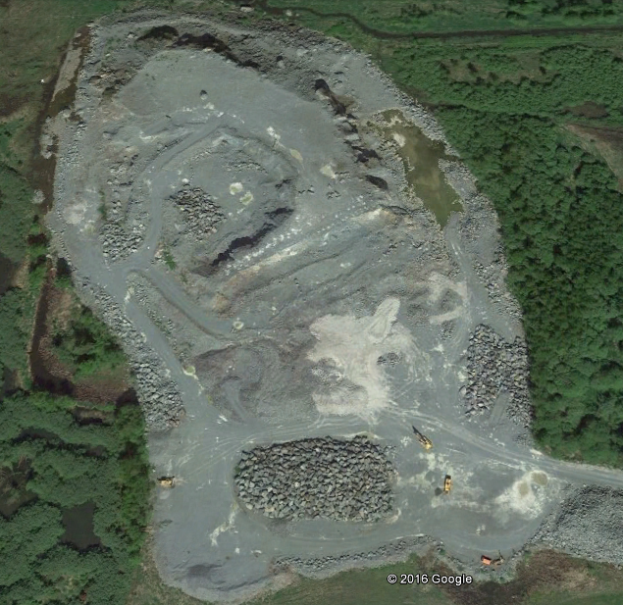
Beaver Lake – Mount Vernon, WA

Slide 3
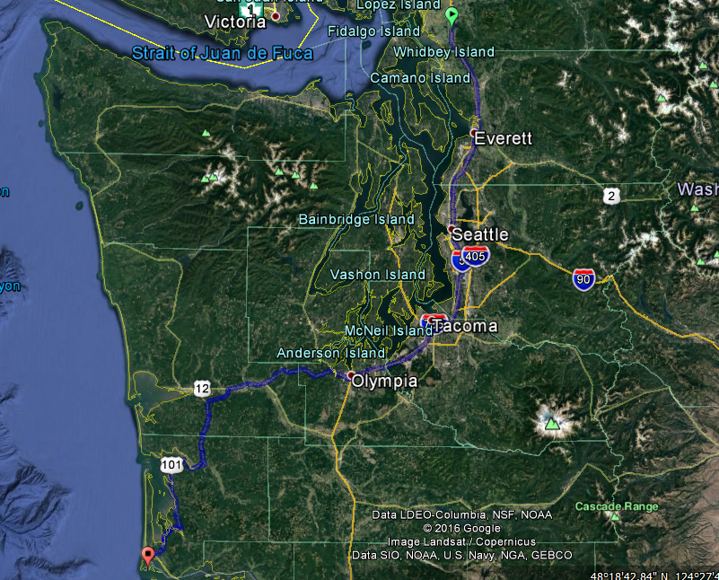
Beaver Lake – Mount Vernon, WA
Trucking
  230 miles by land

Slide 4
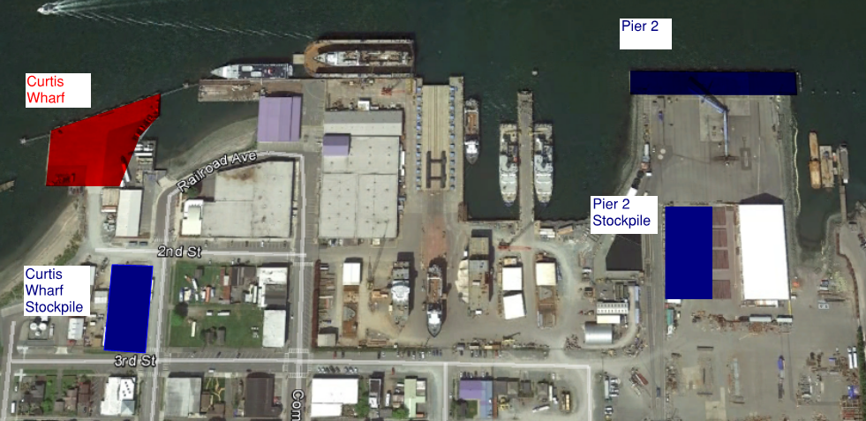
Beaver Lake – Mount Vernon, WA
Barging:
  Trucked 27 miles to Anacortes
  Barged 238 nautical miles

Slide 5
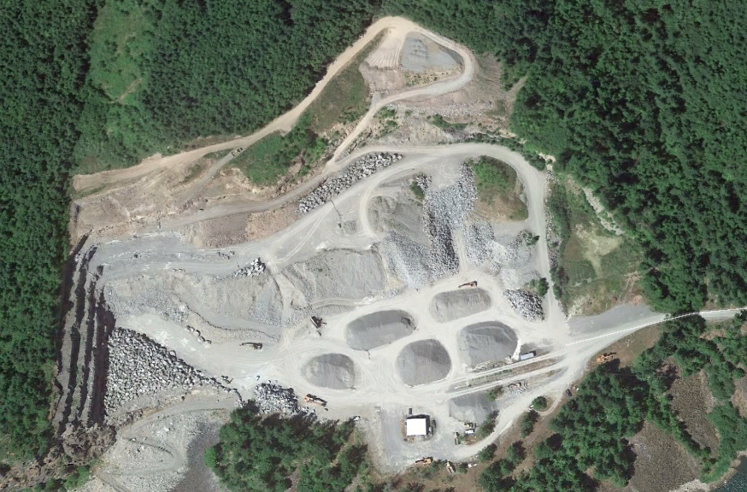
Columbia Granite Quarry– Olympia, WA

Slide 6
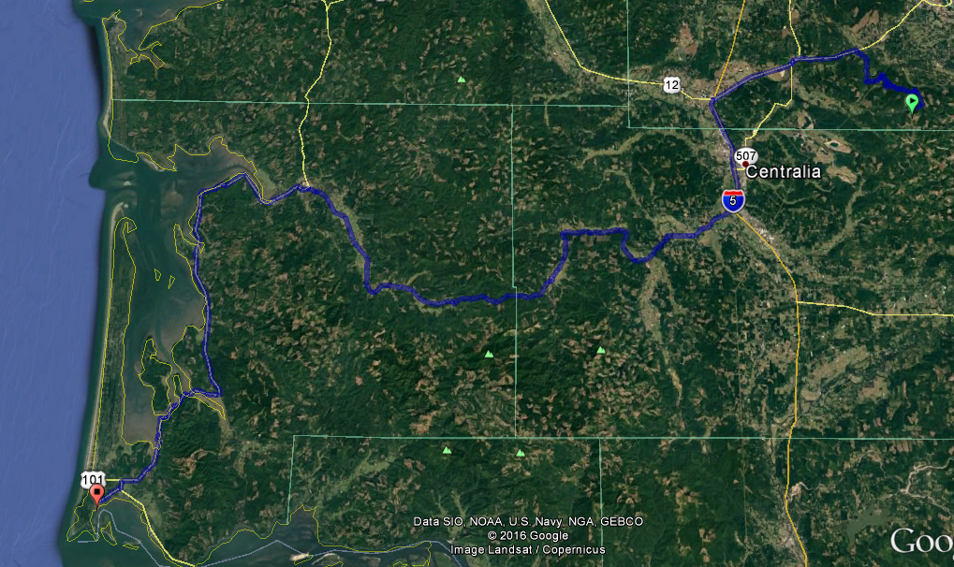
Columbia Granite Quarry– Olympia, WA
Trucking
  135 miles by land

Slide 7
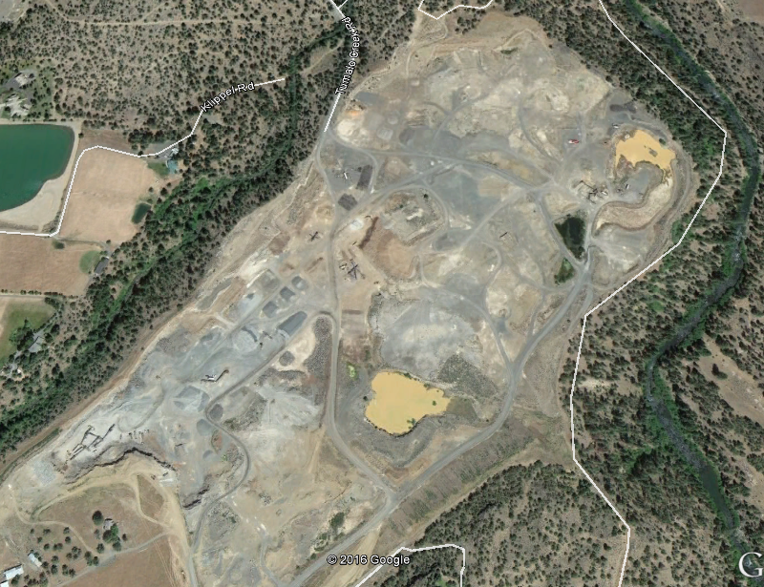
Hooker Quarry– Bend, OR

Slide 8
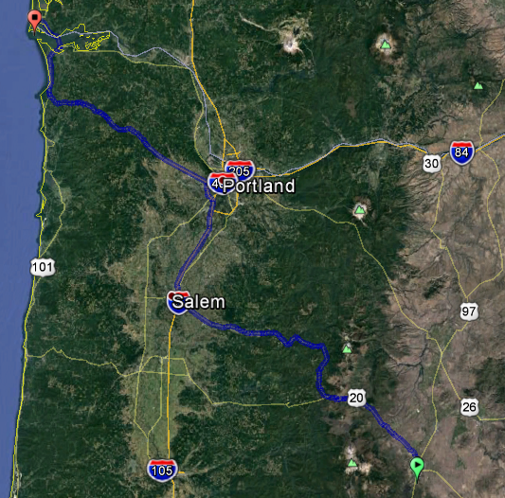
Hooker Quarry– Bend, OR
Trucking
  277 miles by land

Slide 9
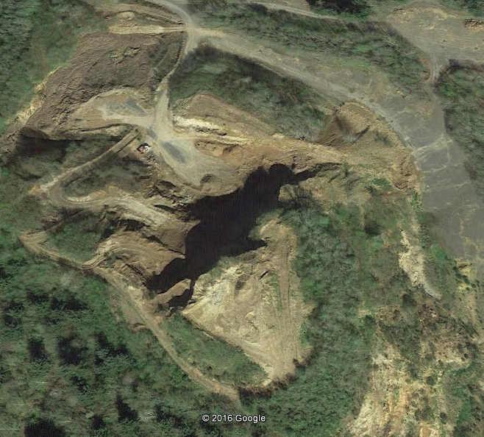
Big River Quarry– Astoria, OR

Slide 10
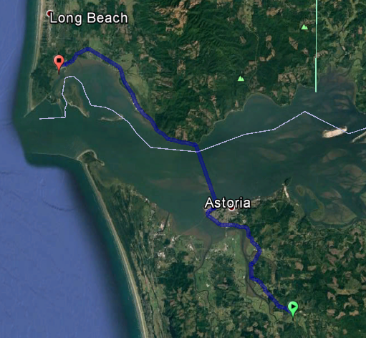
Big River Quarry– Astoria, OR
Trucking
  26 miles by land

Slide 11
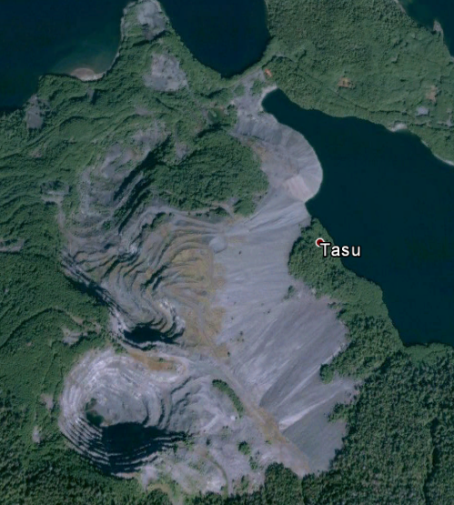
Tasu Quarry– B.C, Canada

Slide 12
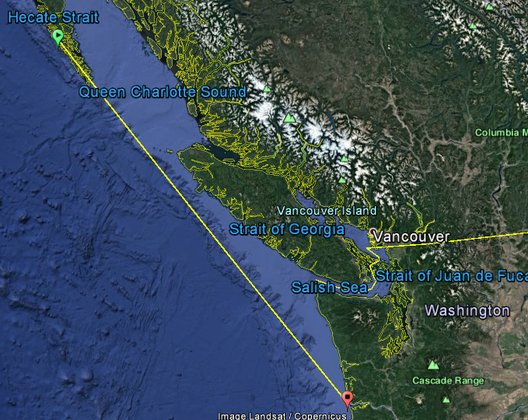
Tasu Quarry– B.C, Canada
Barging
  Barged 510 nautical miles

Slide 13
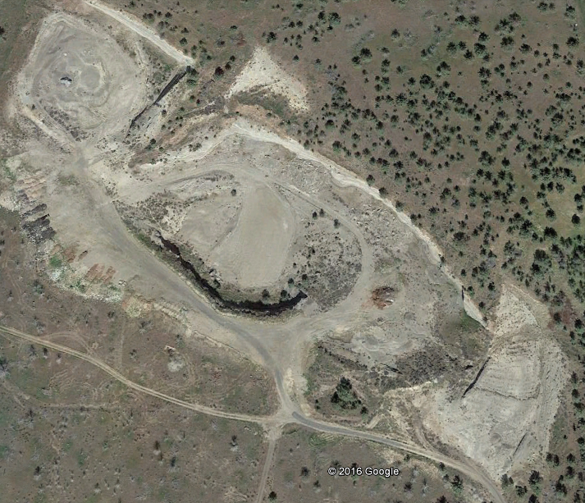
Central Oregon Basalt– Madras, OR

Slide 14
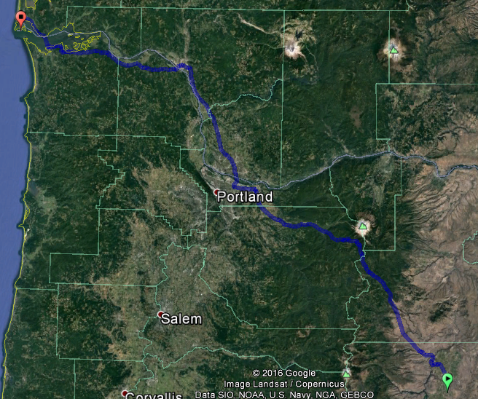
Central Oregon Basalt– Madras, OR
Trucking
  225 miles by land

