Slide 2
2015 ASC Heavy Civil Problem:
Deweyville

Slide 3
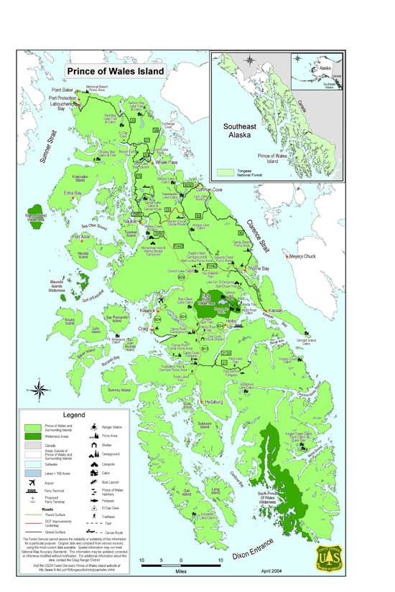
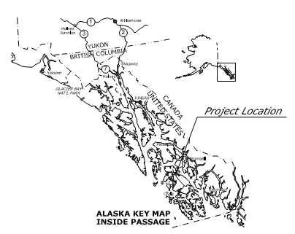
Project Overview
Project Location
Deweyville Trailhead to Neck Lake Road Construction Project for the Federal Highways Administration
Prince of Wales Island, Alaska
Re-construct existing single lane, dirt roadway, to a two lane, paved roadway
Population 5,500 with approximately 100 of them living North of the project
Island logistics

Slide 4
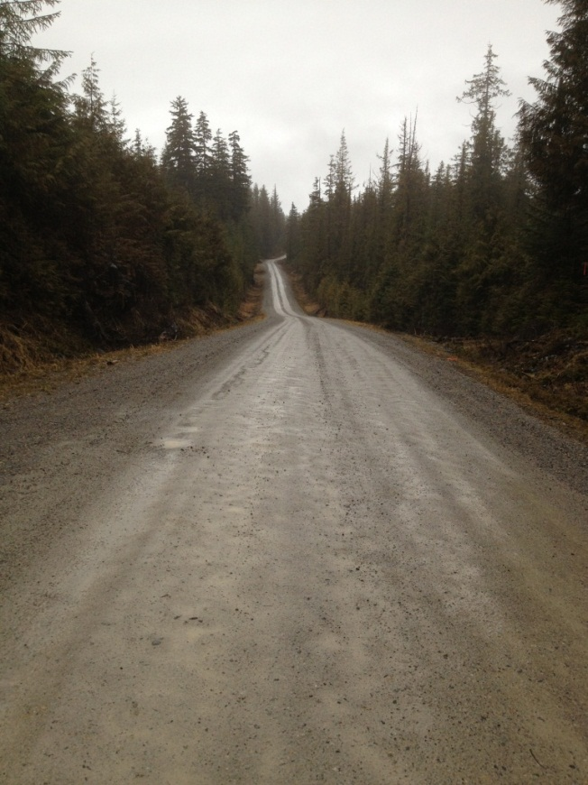
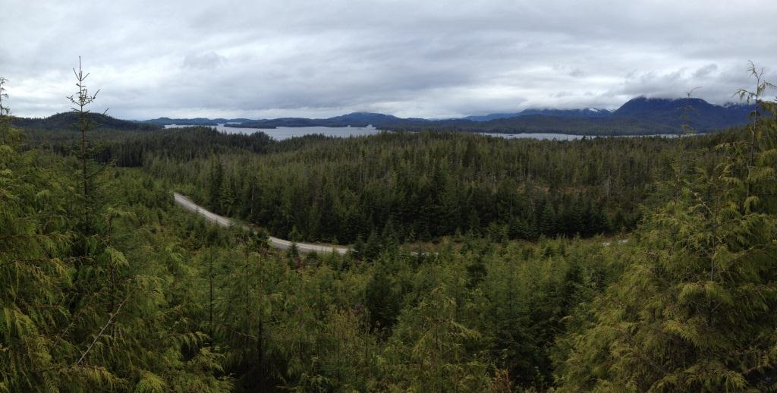
Major Elements
Schedule
Coordinate with other contractors
No equipment rental outfits on the island. No part warehouses… No services.
150 plus inches of rain a year

Slide 5
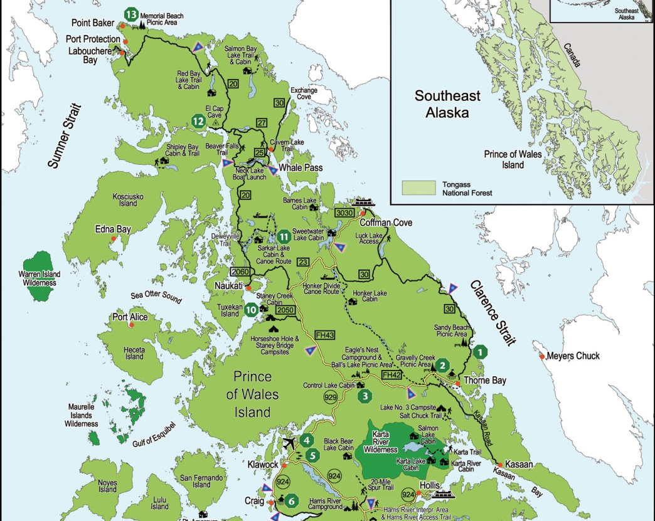
Barge landing

Slide 6
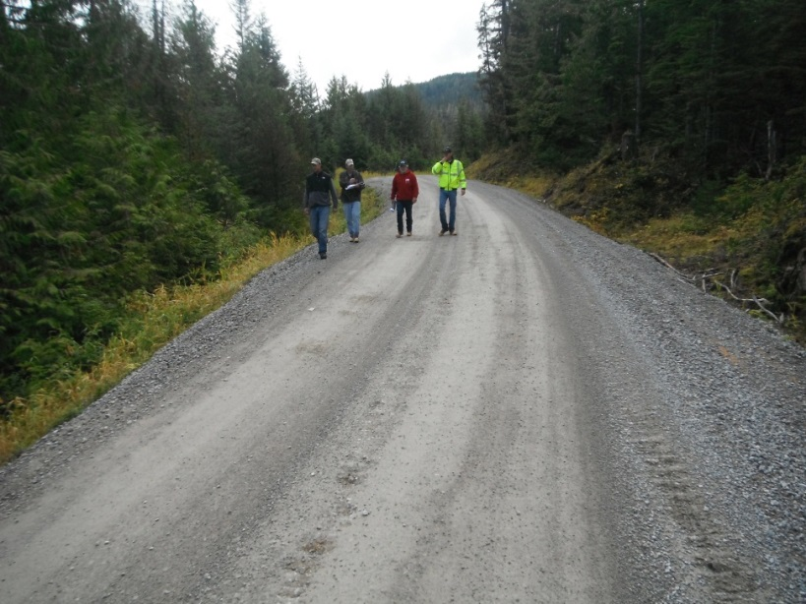
Deweyville – Existing Conditions
Existing Road

Slide 7
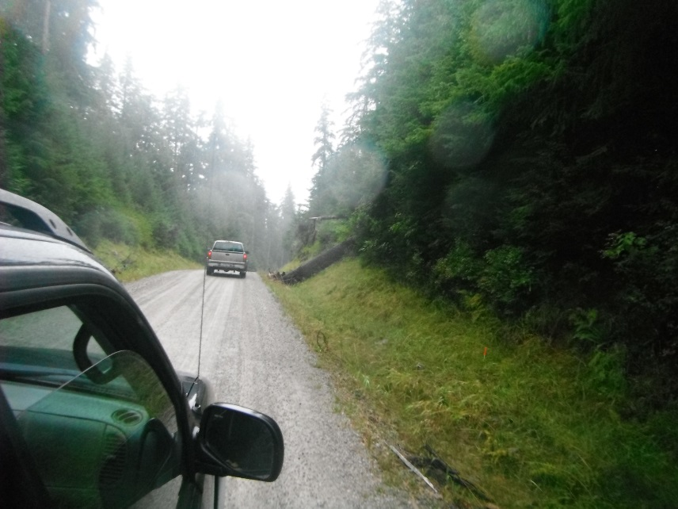
Deweyville – Existing Conditions
Existing Road

Slide 8
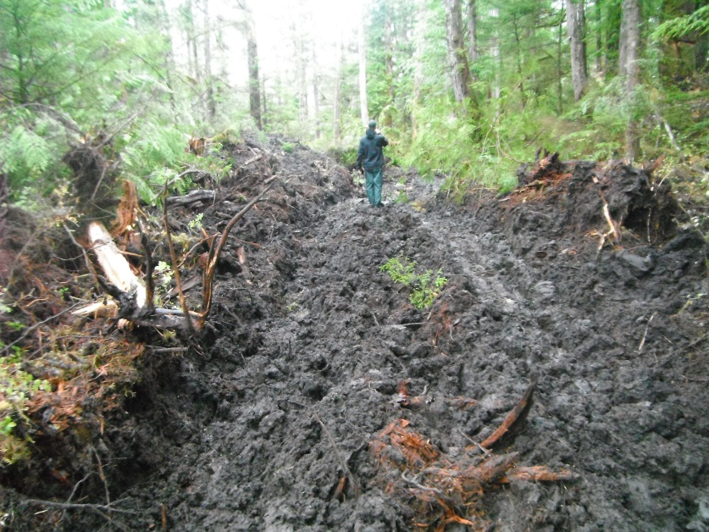
Deweyville – Existing Conditions
Typical overburden

Slide 9
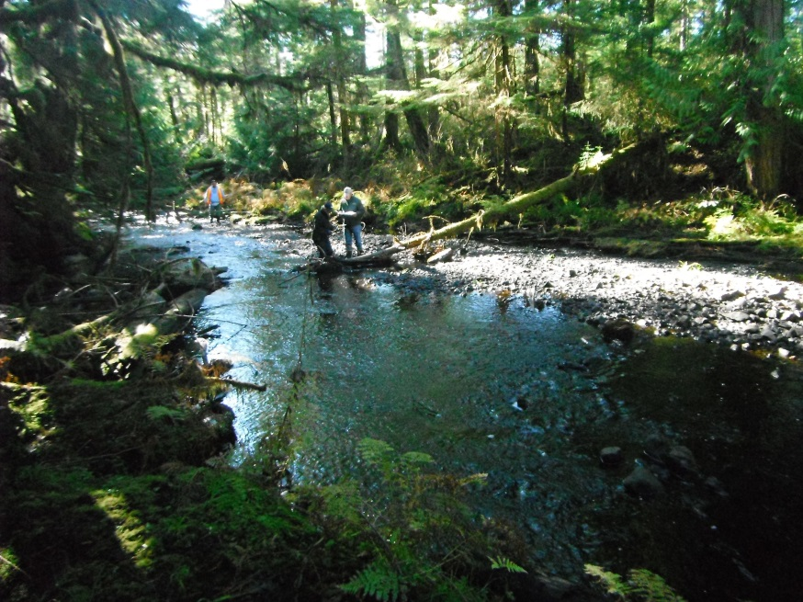
Deweyville – Existing Conditions
Tunga creek

Slide 10
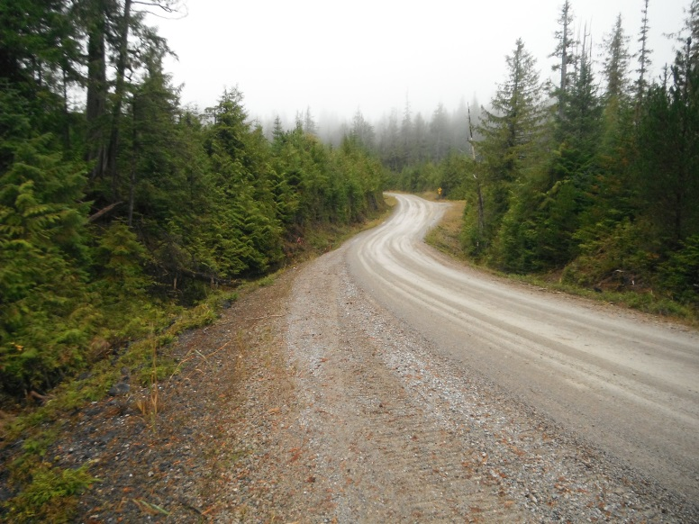
Deweyville – Existing Conditions
Existing Road

Slide 11
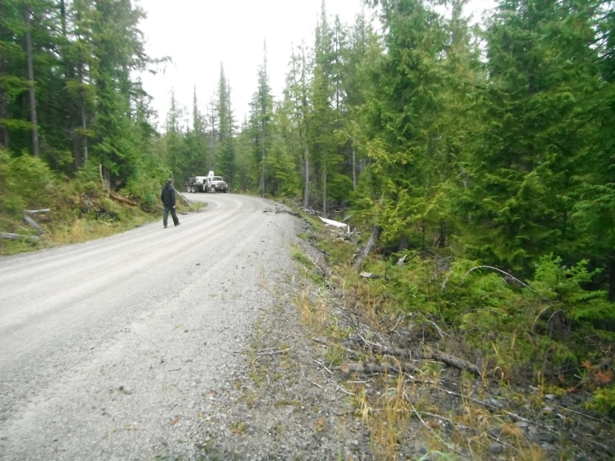
Deweyville – Existing Conditions
Existing Road

Slide 12
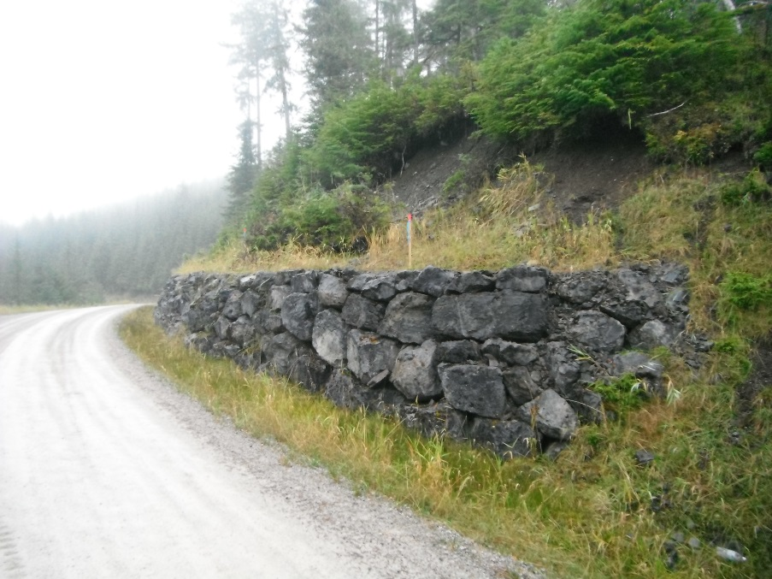
Deweyville – Existing Conditions
Existing Road

Slide 13
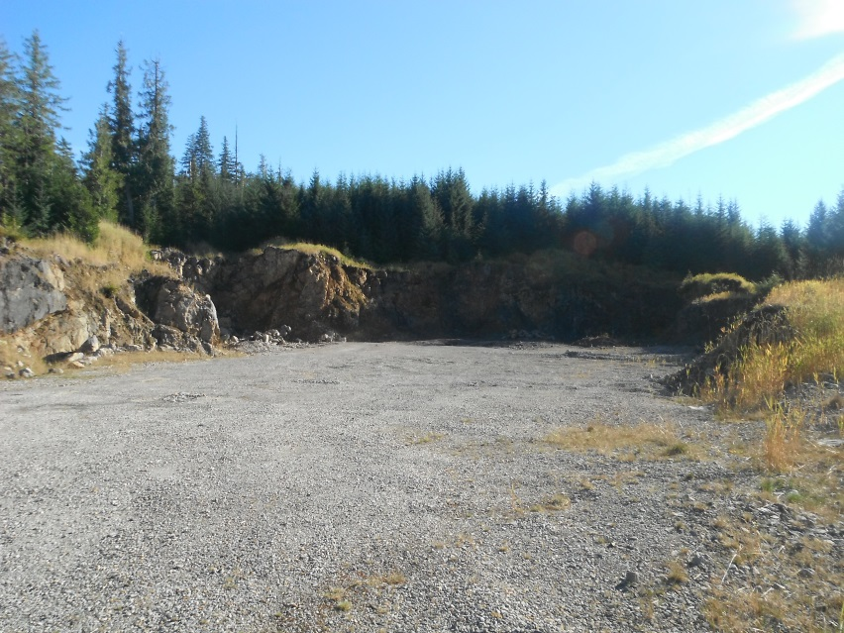
Deweyville – Existing Conditions
Existing pits on the alignment

Slide 14
Deweyville – General questions about the job?

