Slide 1

ASC 2014- Electrical Problem

Slide 2

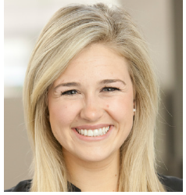


Introductions-
CEI Day-Of Support Team
Day Of Support
Marina Gilmore
Marina_Gillmore@cei.com
Correspondence with customer
  Change Orders
  RFIs
Anne Brummett
Anne_Brummett@cei.com
Bidwinner Support
RFQ’s
Questions Requiring Immediate Assistance: 415-850-1715
Megan Fox
Megan_Fox@cei.com
General Questions

Slide 3

7 am Meeting Agenda
Problem Download
Informational Session
  Project Information
  San Francisco Specific Code Requirements
ASC Schedule
Deliverables

Slide 4
Problem Download-
We need your help with a project in progress
Job Binder
  Specifications
  Building Rules and Regulations
  Original Project Estimate
  Change Order Log with backup
  Submittal Log and associated submittals
  RFI log and associated RFI’s
  Project Schedule
  Rate Sheet
Flash drive with standard forms

Slide 5

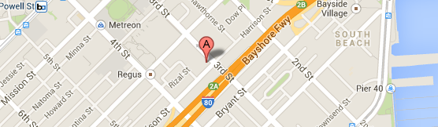
SPKR- 360 3rd Street
Located at 360 3rd Street at Harrison Street in the South of Market district neighboring downtown San Francisco and Union Square.
SPKR is a high end Digital Advertising Client with a cutting edge, modern aesthetic. Their collaborative culture requires an open concept floor plan with Huddle and Conference Rooms and minimal private offices.
Aside from the suite under construction, the building is occupied

Slide 6
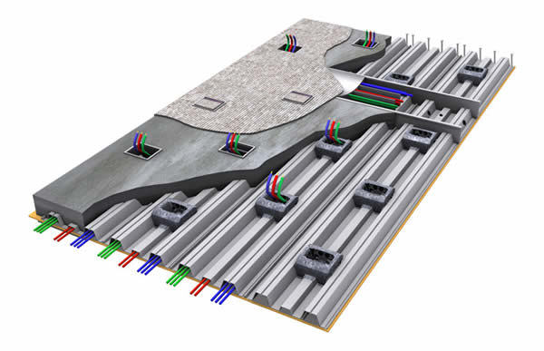
360 3rd Street- Floor System
Power to floor mounted devices are fed via a cellular floor system.
  Cellular floor raceways are electrical wiring ducts or cells made from steel floor deck that serve as structural formwork for placement of concrete floor slabs and also as wire and cable raceways within the concrete floor slab.
  What does this mean to us?
    No raceways required- Wire only
    No need to core through the deck
      Core into cell only
    Inexpensive devices

Slide 7
360 3rd Street- Noteworthy Building Rules
All coring must be performed off hours
  Before 7am or weekends.
All deliveries must be scheduled with the loading dock manager 48 hours in advance of delivery.

Slide 8
Noteworthy Union Requirements
Local 6 (San Francisco electrical workers union) working hours are from 8am to 3:30pm.
Electricians work 5 days per week (35 hours)- straight time.
The first two evening hours are considered overtime (x1.5). Any additional time beyond these two hours is double time (2x).
If no OT hours are worked during the week, electricians working Saturdays will be paid OT (x1.5).
If any overtime was performed during the week, electricians must be paid double time (2x)for the entire day.

Slide 9
Let’s Talk Deliverables
Deliverables include, (but are not limited to) the following:
  Man-loaded Schedule
  Reconcile the Change Order Log
  Reconcile and complete the Submittal Log
  Projection of final project costs to complete
This problem is based on an actual “day in the life” of a Electrical Project Manager. Additional deliverables may come up throughout the day.

Slide 10
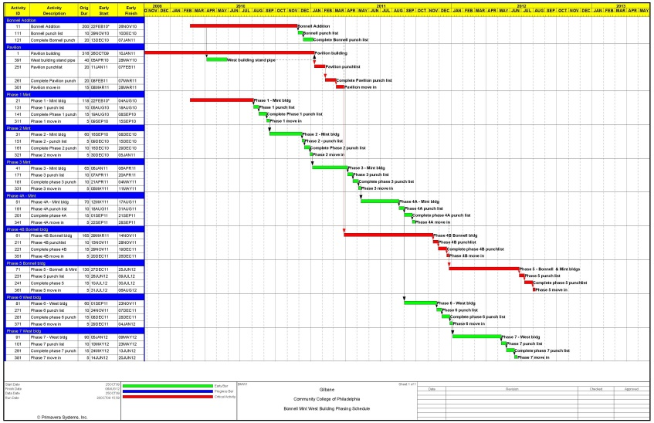
Man-Loaded Schedule
Please complete a CEI specific schedule based on the GC schedule provided.
  Utilize the hours in the estimate to come up with crew sizes required for each task.
  Identify all electrical milestones.
  Include anticipated delivery and installation dates of quotable materials and incorporate into the CEI schedule.
Be prepared to demonstrate your knowledge of electrical sequencing on a TI project.

Slide 11

Reconcile the Change Order Log
Please review the change order log and change order backup provided.
Please verify the log for completeness and update if/ as necessary. Some follow up may be required.
More information regarding change orders will be provided at 9am.

Slide 12
Reconcile the Submittal Log
Review the Submittal Log and Backup Provided.
Please review for completeness
Please review:
  Submittal Status
  Approval Status
  Release Status
Submit/ Release/ Follow up as required by the project.
See project specifications for submittal requirements

Slide 13
Project Projections
Final Goal
Monthly projection meetings are conducted to capture a snapshot of the current job status and the projected profitability of the job. That snapshot includes the status of material expenditures, general expenses and labor projections.
The financial information that is provided is used to provide overall branch projections.
More information regarding project cost projections will be provided at 9am.

Slide 14
Project Review Meeting Notes
Please come prepared to speak to your project approach to SPKR specifically. Any presentation materials that are not problem specific or related the to project deliverables will be discarded and deductive points will be issued.
The oral portion will be in a PM Review format. Teams will present their projected project costs and profitability.
Teams will be expected to understand the project deliverables and the day-of challenges and be able to explain their relationship to the overall status of their job (projection).

Slide 15
Know your audience
Julie Stice- Division Manager
  The Bottom Line
Jeremy Walson- CFO
  Project Financials
Chris Bizot- VP of Sales
  Customer Relations and Change Order Approach
Erin Rolita- Project Executive
  Project Progress
Mark Lopez- General Superintendent
  Manpower, Schedule and Status of Materials

Slide 16
Schedule
Thursday
  7am- Problem Kick-off Meeting
  9am- mandatory change orders and project projections class.
    All team members are required to attend.
  Noon(ish)- Lunch
  11pm Deliverables are due
    Please hand deliver to the Judges Suite.
Friday
  8am- draw for presentation time slot @ presentation room
  9am- 1st presentation
  Noon- Break
  1pm- Resume presentations
  6pm- Closing recap presentation by CEI
  6:30- Thank you hour with Networking

Slide 17

Questions?

